Slide 1

DEPARTMENT OF COMPUTER SCIENCE AND ENGINEERING CMR TECHNICAL CAMPUS UGC AUTONOMOUS (Accredited by NAAC, NBA, Permanently Affiliated to JNTUH, Approved by AICTE, New Delhi)Recognized Under Section 2(f) & 12(B) of the UGC Act.1956, Kandlakoya (V), MedchalRoad, Hyderabad-501401. 2018-2022
Under the Guidance of:
R.DILEEP KUMAR
Team Members:
J.Navaneeth (187R1A05E1)
K.Shivadeep (187R1A05E4)
J.Pavan (187R1A05E9)

Slide 2
STOCK MARKET PREDICTION USING MACHINE LEARNING

Slide 3
ABSTRACT:
Stock market is place where people buy and sell shares of publicly listed companies.
Every buyer and seller try to predict the stock market price movements to get maximum profits and minimum losses.
Using cutting edge technology such as AI can improve prediction stock price.
The stock market is characterized by extreme fluctuations, non-linearity, and shifts in internal and external environmental variables.
Artificial intelligence (AI) techniques can detect such non-linearity, resulting in much-improved forecast results.
The future price of a stock is the main motivation behind the stock price prediction. In various cases like business and industry, environmental science, finance and economics motivation can be useful. The future value of the company’s stock can be determining

Slide 4
EXISTING SYSTEMS:
In the present system the various algorithms used for forecasting can be divided into queues (AR, MA, ARIMA, ARMA) and incompatible models (ARCH, GARCH, Neural Network) and AI framework such as Naive Bayes, the closest neighbours k (k-NN), Support Vector Machine (SVM), Linear Regression, and Random Forest were used to advance the gauge model. Points are settled on stock values.
Current models predict that the stock market uses only one algorithm to predict different conditions and variables and also does not combine multiple algorithm results or consider multiple algorithms to accurately predict. Previous results indicate that the stock price cannot be calculated using traditional divisions.

Slide 5
DRAWBACKS:
The current system does perform optimally if there is a change in the operating surrounding because it does not focus on external events occurring in the surrounding such as news events and other factors affecting prices such as the Forex and Commodity market.
Most of the existing systems uses only one algorithm and one data at a time. The existing system also does try to predict share prices in all conditions and on all days but in real world share market cannot be predictable every time so certain conditions need to be checked before predicting share market.

Slide 6
PROPOSED SYSTEM:
In this proposed system, we aim to predict the future share prices using various machine learning methods. In this proposed system, we were able to train and test the algorithms of ML from the different data points from the past for making the future share price estimation.
The features of these data frame were date, close, open, high, low, volume, delivery percentage, number of trades, turnover and other derived features. All features were used by us to train machine of a random forest model and predicted the object variable, and we used some selected features to predict using the LSTM, LMS algorithm also which was the values of share of upcoming day.
We also measured the accuracy of prediction on the test dataset and on real values. The presented method includes different aspects of research including data manipulation and pre-processing.
System uses ANN (Artificial Neural Network) for sentiment analysis of news data, and Google stock API for fetching real time data of news related to stock market.

Slide 7
ADVANTAGES:
By combining the LMS, LSTM algorithms we get the accurate results than previous results which the algorithms used separately.
By using RNN we get the best prediction according to the external environment.
Takes less time than existing systems to predict.
Higher Efficiency.

Slide 8
Software Requirements
FRONT END : PYTHON 7.3
OPERATING SYSTEM : WINDOWS 10
IDE : colab

Slide 9
Hardware Requirements
Processor : Intel Dual Core@ CPU 2.90GHz
RAM : 1GB and above.
Space on Hard Disk : 4GB

Slide 10

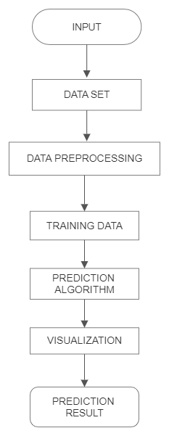
PROJECT ARCHITECTURE:

Slide 11
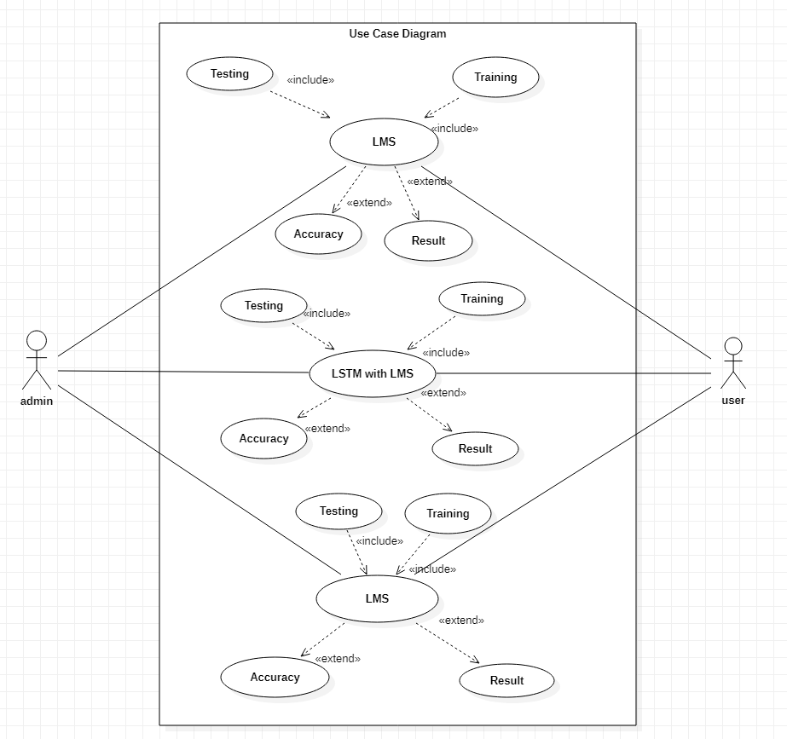
Use Cases:

Slide 12
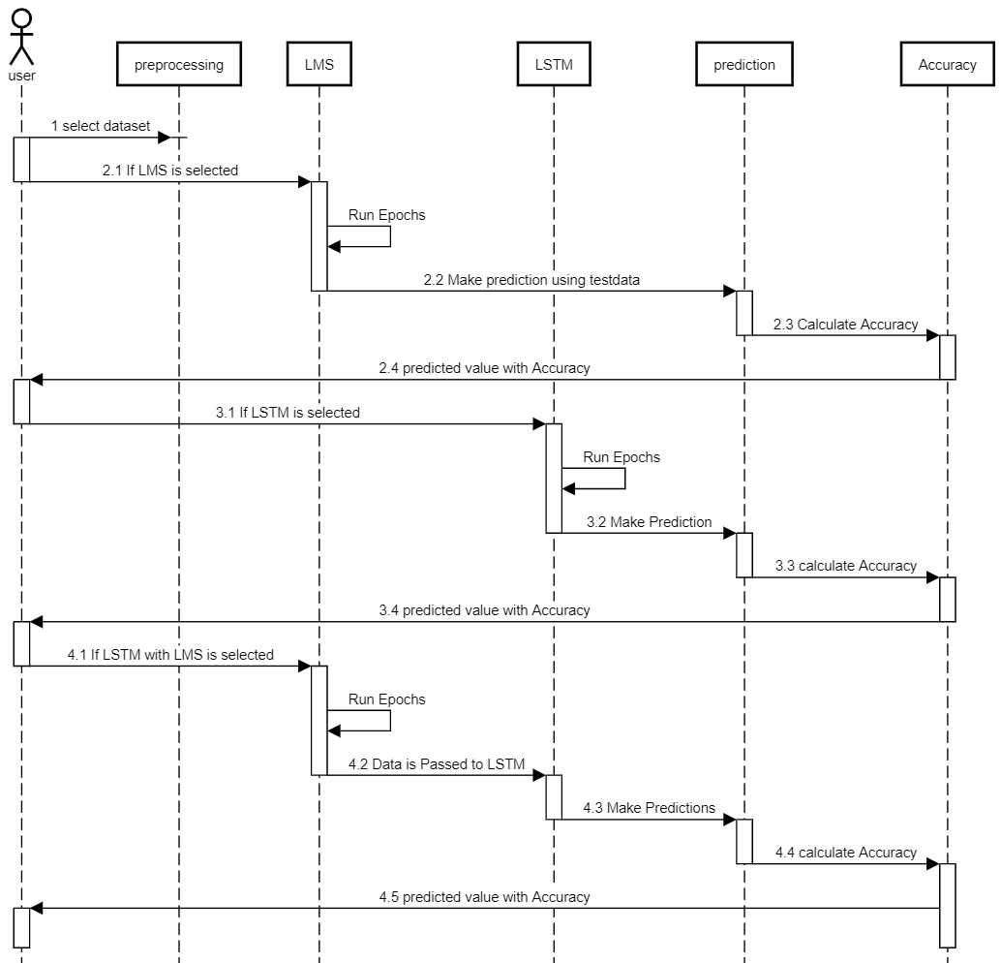
Sequence Diagram:

Slide 13
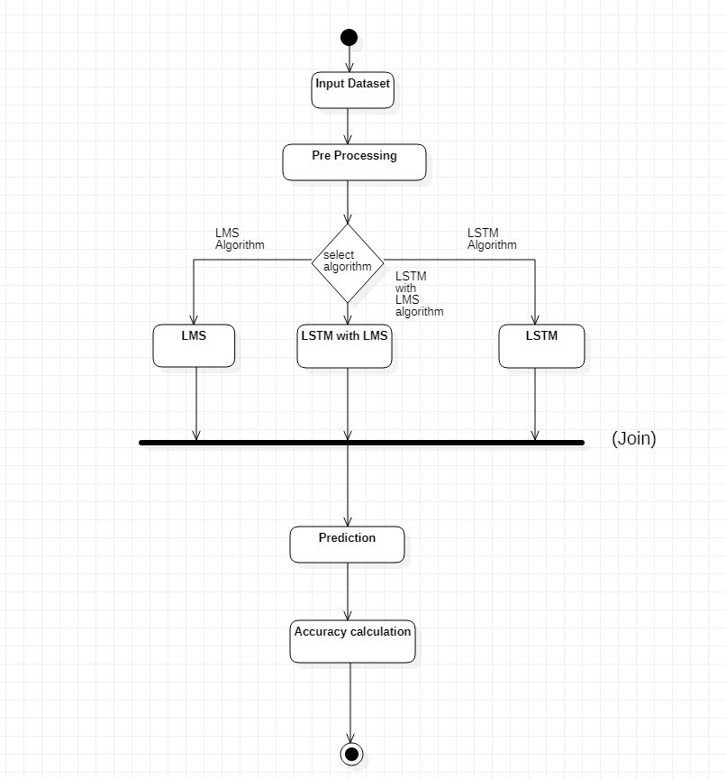
Activity Diagram:

Slide 14
MODULES
1.Raw DataSet
2.Data Preprocessing
3.Feature Extraction
4.Training Neural Network
5.Visualization

Slide 15
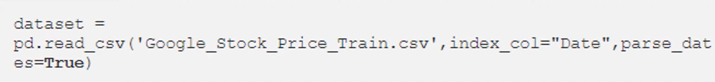
Sample code #1 RAW DATA
The Historical Stock data is collected from the google stock price and this historical data is used the prediction of future stock prices.

Slide 16
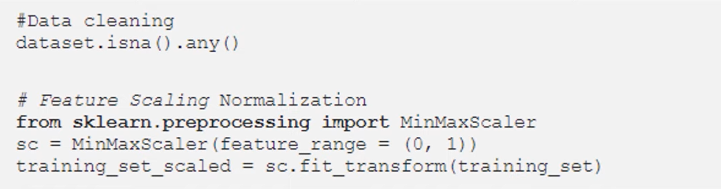
#2 Data preprocessing
The Preprocessing stage involves data discretization,data transformation,data cleaning,data integration.After the data set is transformed in to clean dataset ,the dataset is divided in to training and testing sets to evaluate.

Slide 17
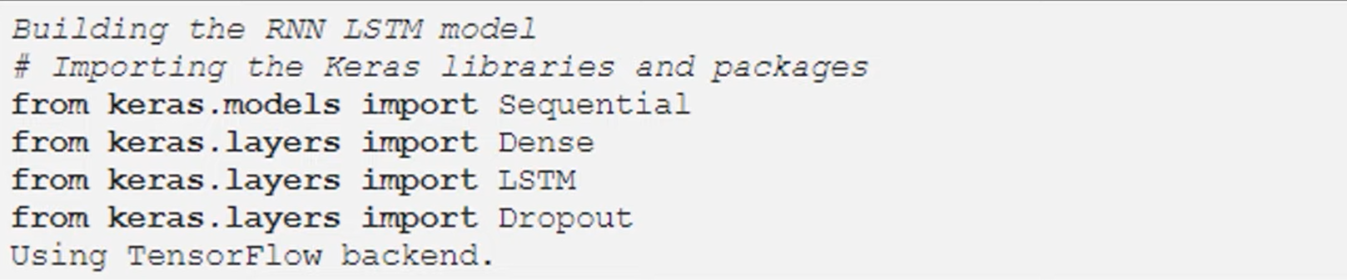
#3 feature extraction
In this layer,only the features which are to be feed to the neural network are choosen.

Slide 18
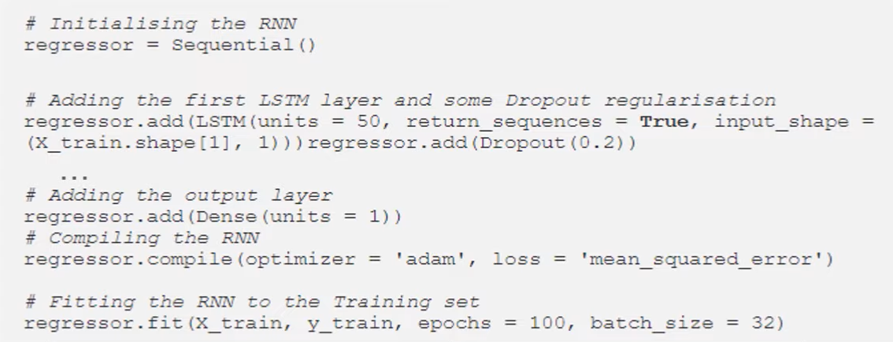
#4 Training neural network
In this stage the data is fed to the neural network and trained for prediction assigning random biases weights.

Slide 19
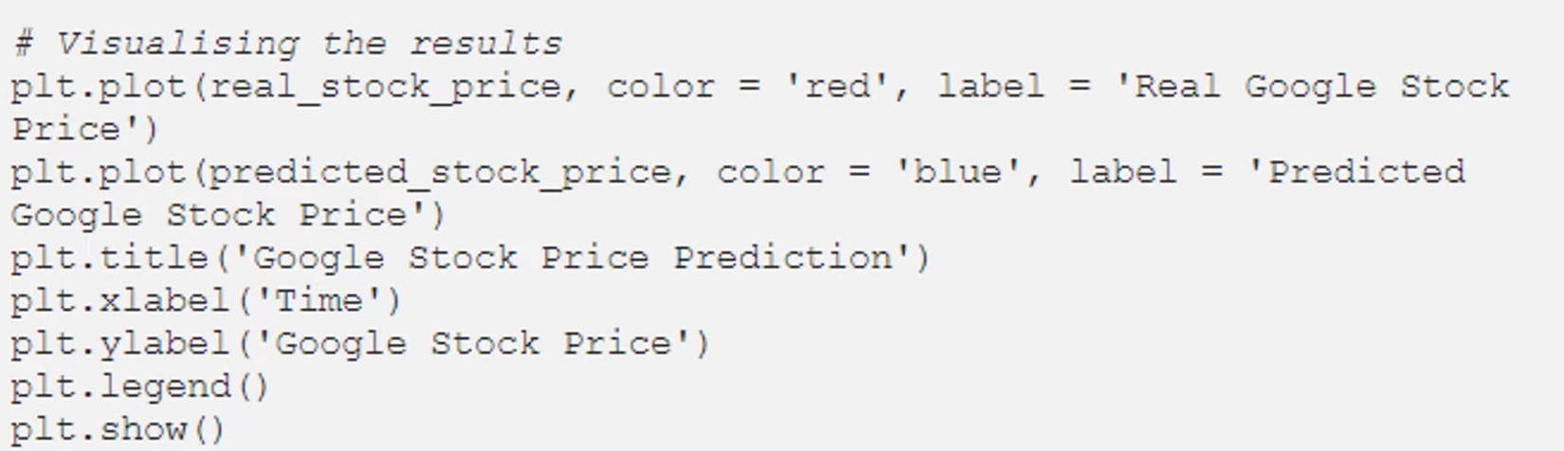
#5 visualization
A rolling Analysis of a time series model is often used to access the models stability over time.When analyzing financial time series data using a statistical model,a key assumption is that the parameters of the model are constant over time.

Slide 20
Future enhancement
Using more granular data such as data of every minute, every second or tick by tick data can improve accuracy of prediction as it contains more insightful information than one day data.
Future work contains providing predictions and recommendations for individual according to its risk and reward appetite, and also providing a portfolio management to mitigate the risk associated with investing in stock market.
Process of placing orders and making trades can be automated which work according to suggestions given by AI and ML algorithms, which can remove human errors and factors such as fear and greed of human being which can result in faster and more profitable trading.

Slide 21
CONCLUSION
By estimating the parameters of accuracy, it was found that the most appropriate method for stock market prediction is to use multiple algorithms such as RNN, LSM, LSTM and combine their results for predictions, and also considering all the factors affecting the stock market price such as news sentiment, currency, commodity prices and other international stock exchange market data. High accuracy was achieved by doing all this. Considering other factors affecting the stock price improves accuracy of prediction. Trying to predict the stock market only when its more predictable and avoiding when market is more uncertain gives greater profits

Slide 22
ANY QUERIES?

Slide 23
THANK YOU

